Slide 1
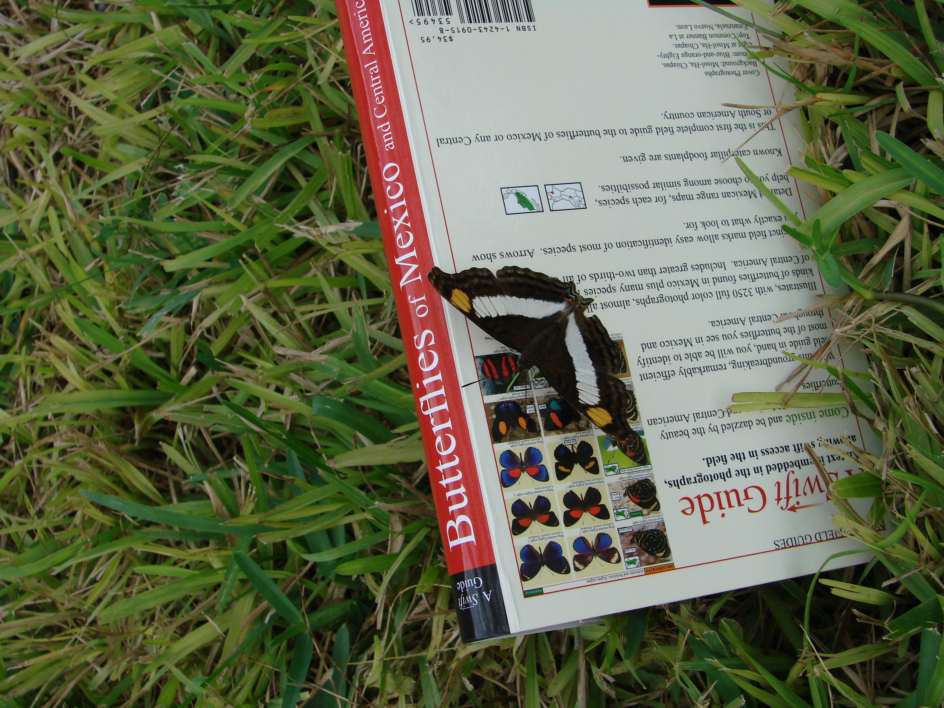
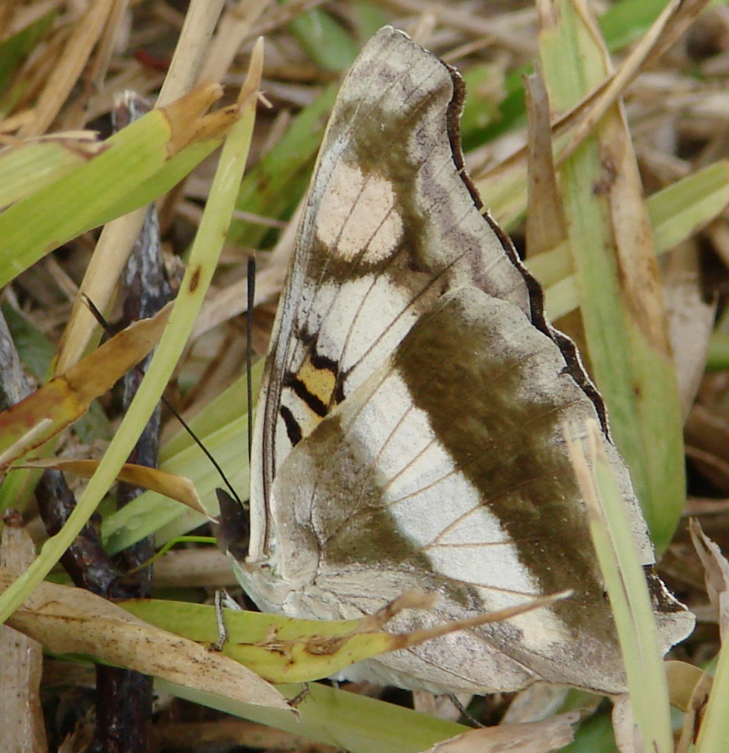
An RGV Butterfly
Journey
Berry Nall Texas Butterfly Festival 2025
Well-read Female Silver Emperor 11-17-07

Slide 2
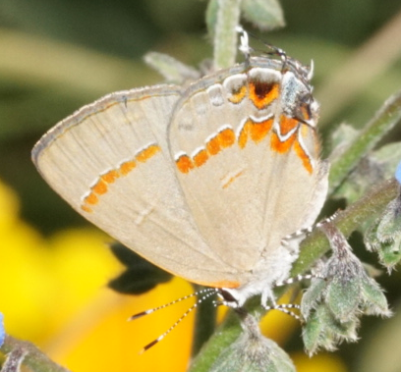
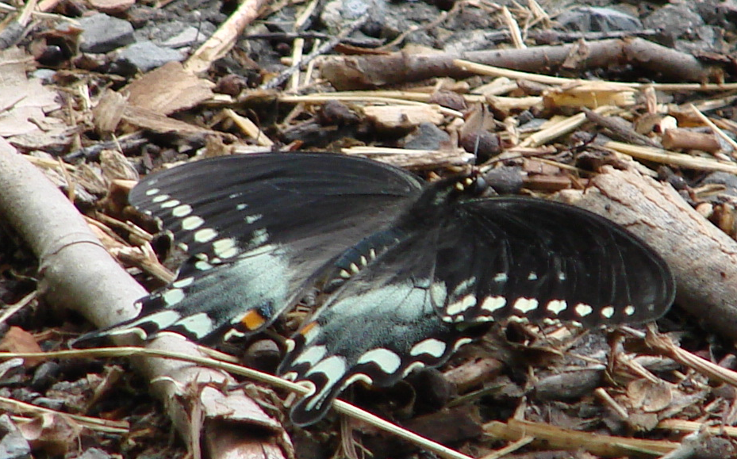
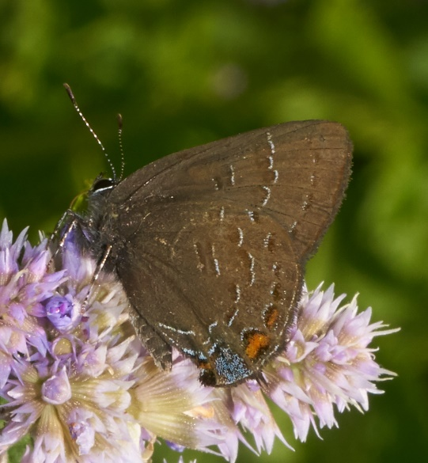
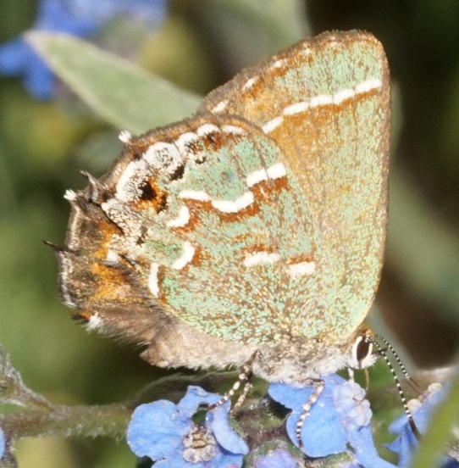
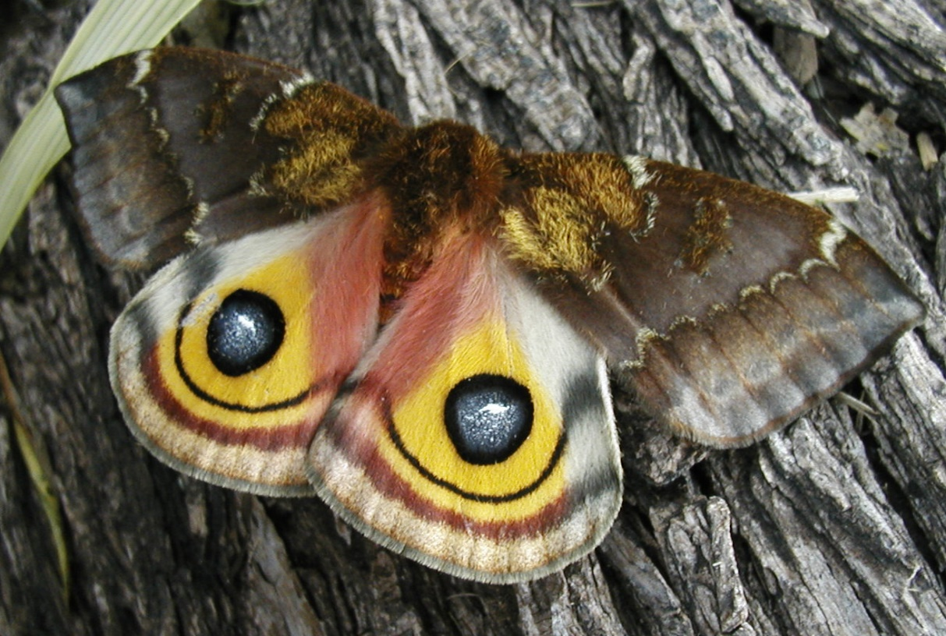
Background
In childhood chased butterflies and moths around MD-VA
Moved to TX in 1987 to pastor Falcon Heights Baptist Church
Became bivocational in 2001, teaching science (and now Engineering and Computer Science) at Roma High School
Lepidoptery interest revived when I obtained a digital point-and-shoot 2003 or 2004
Began photographing butterflies I found and trying to identify them; also began growing plants to attract them
By early 2007, I felt comfortable enough with common IDs to start keeping a monthly list

Slide 3
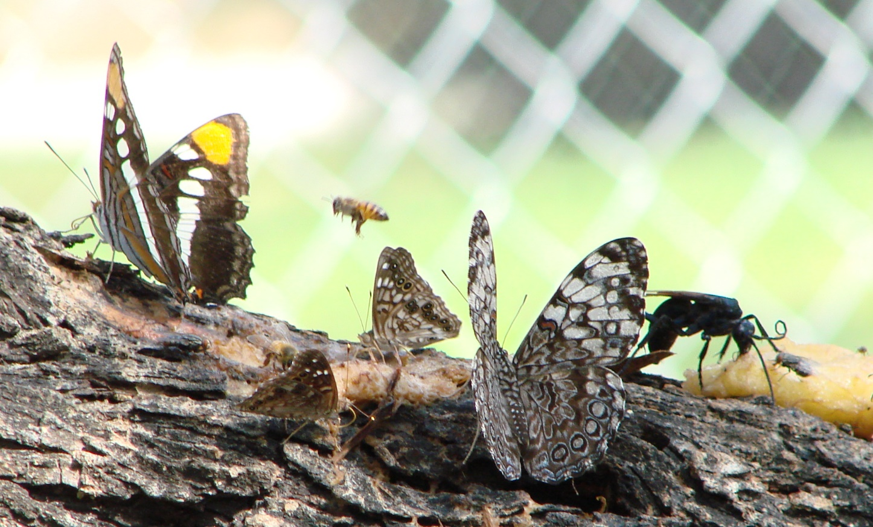
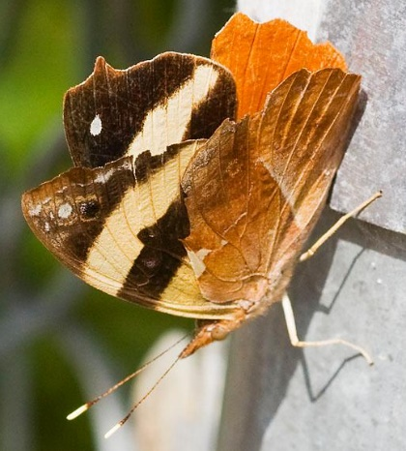
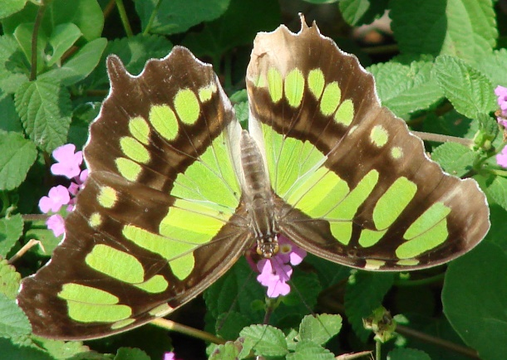
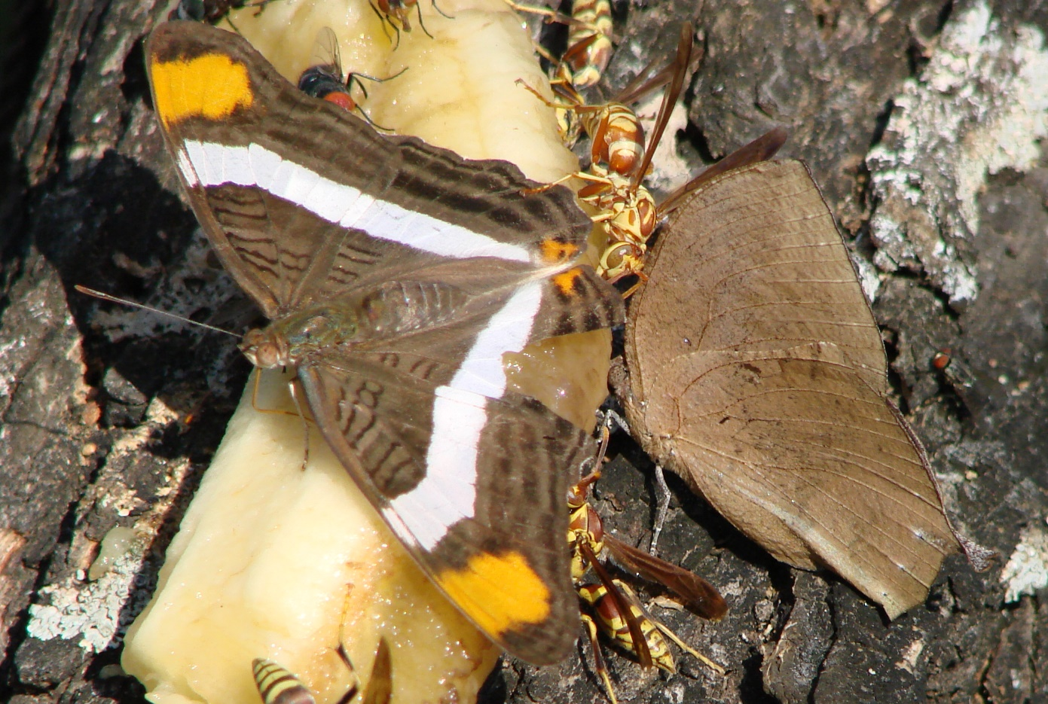
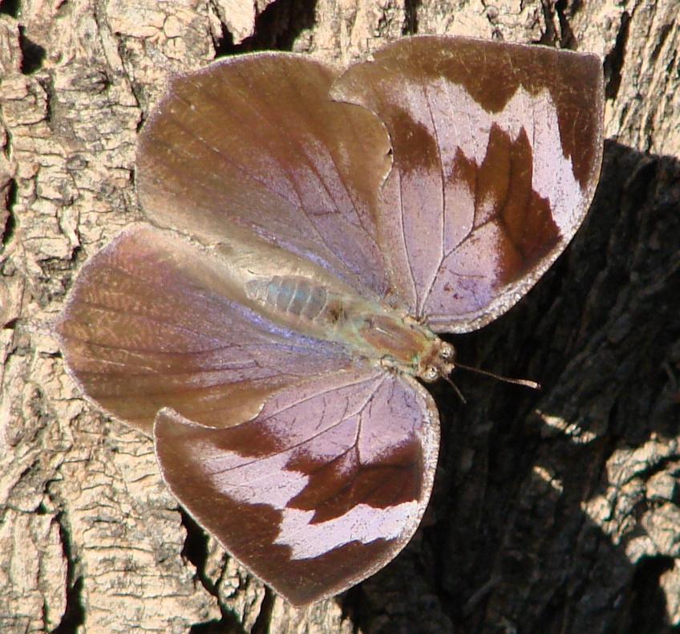
2007-08: Magical Times
Common Banner
105 yard species in October; 15-17 HS species in one day at FSP
Some incredible yard rarities in November
People came to my “garden” to see these
--then rushing from Guatemalan Leafwing to NBC to see One-spotted Prepona
11-7-2007
Arizona sister, Guatemalan Cracker
Malachite
11-18-2007
Band-celled Sister, Guatemalan (Forrer’s) Leafwing
Notes:
Garden was little more than a long row of plants and a bait log

Slide 4
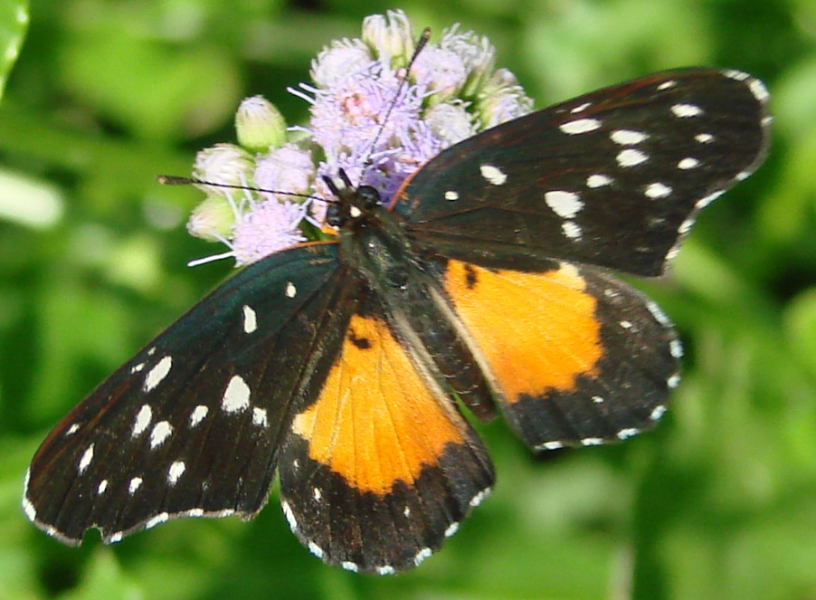
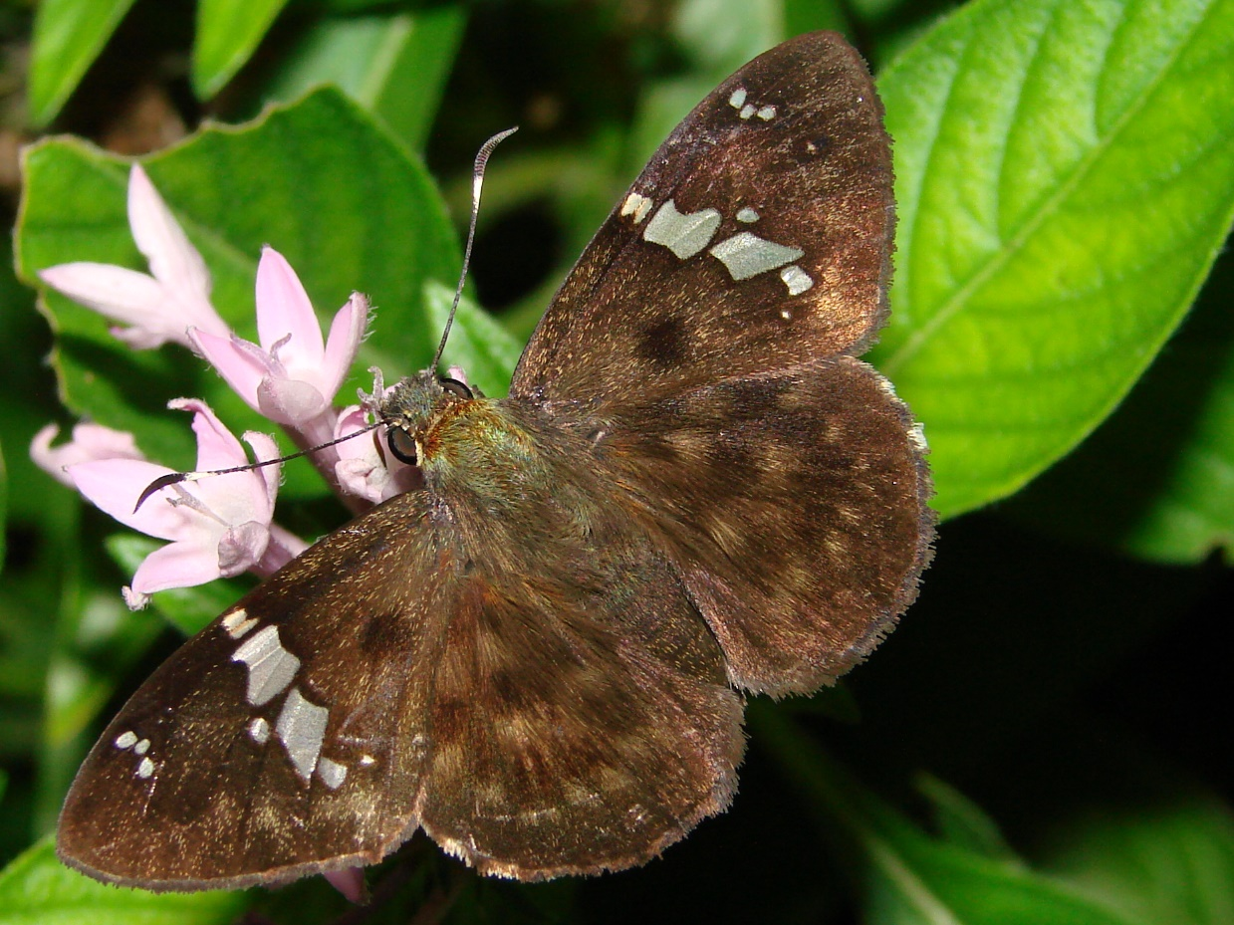
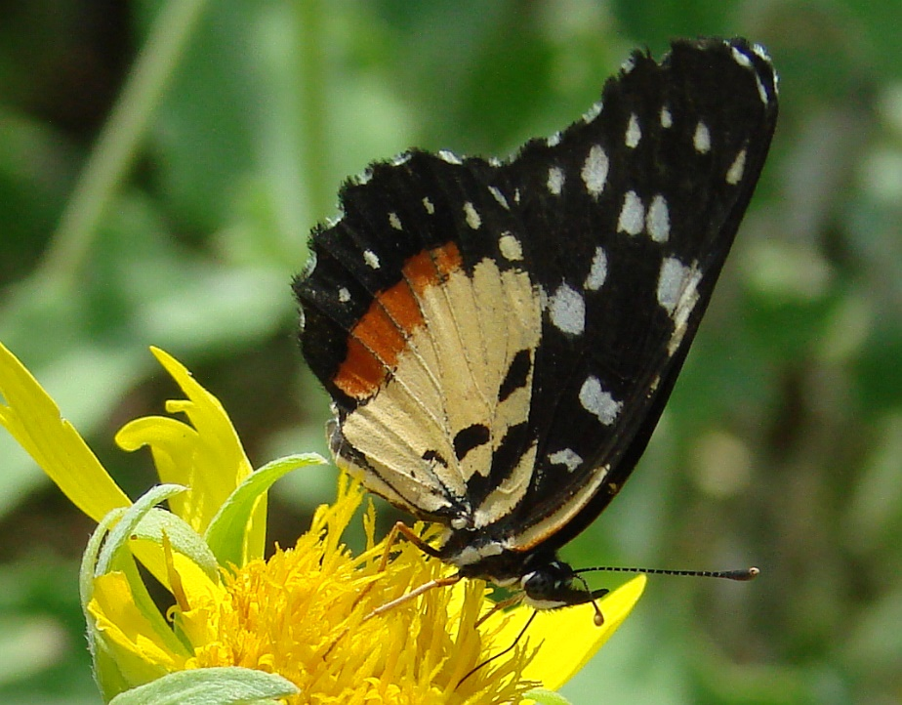
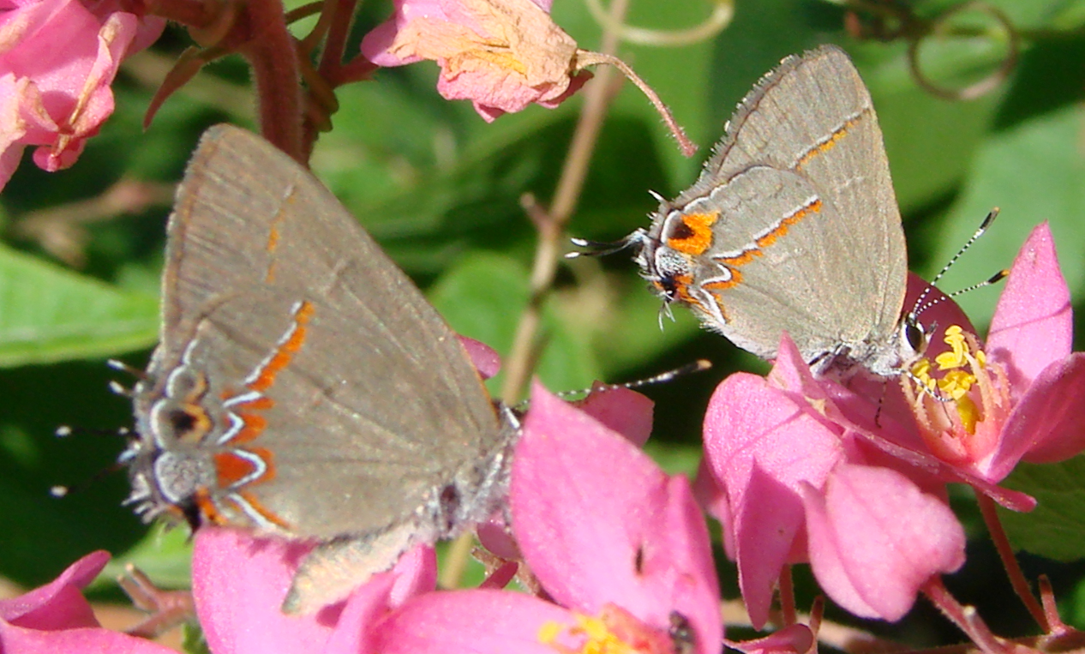
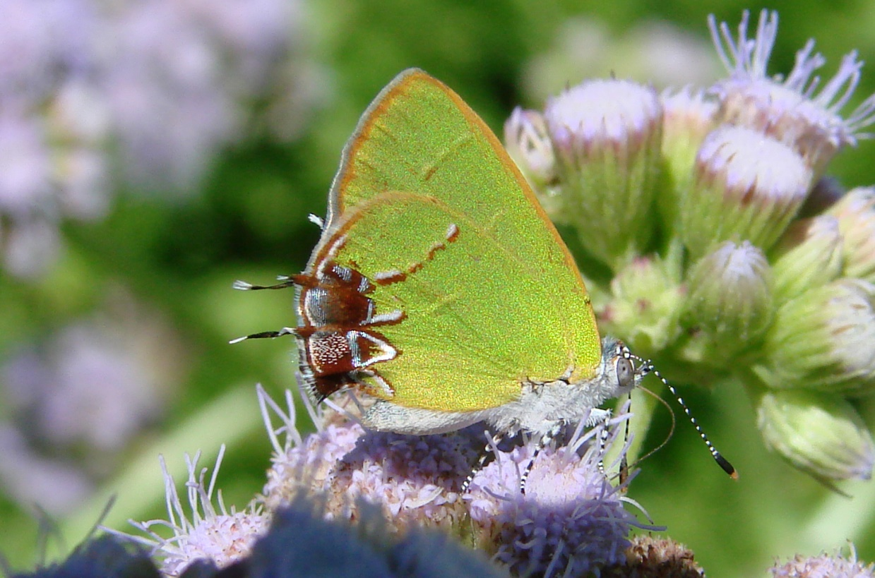
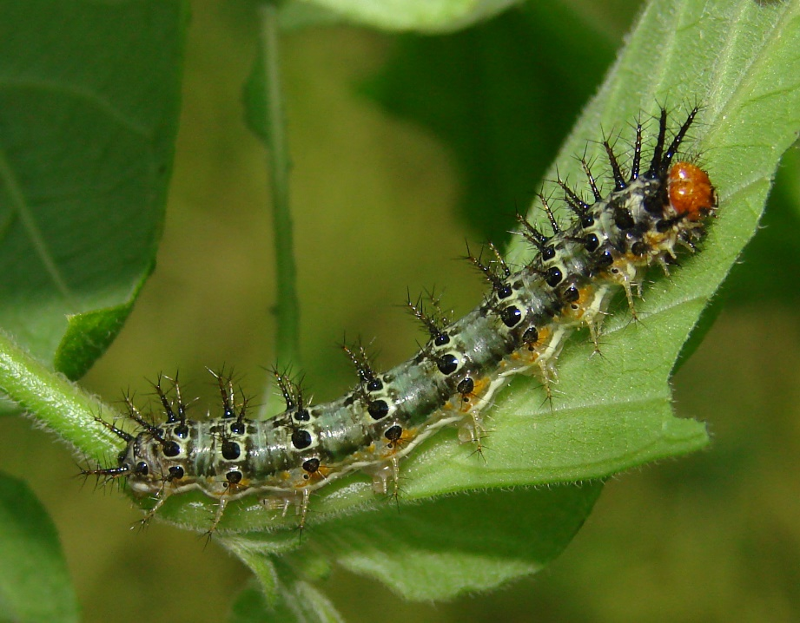
2007-08: Magical Times
Clockwise from right:
Stallings’ Flat, Telea Hairstreak, Ruddy (r) and Dusky-blue Hairstreaks, and Rosita Patch (caterpillar, ventral, and dorsal views)
Notes:
More pix. Opening of FSP Garden and my own huge success; led me to think this was “normal” for Starr County! Who wouldn’t be excited and captivated by this show?!

Slide 5
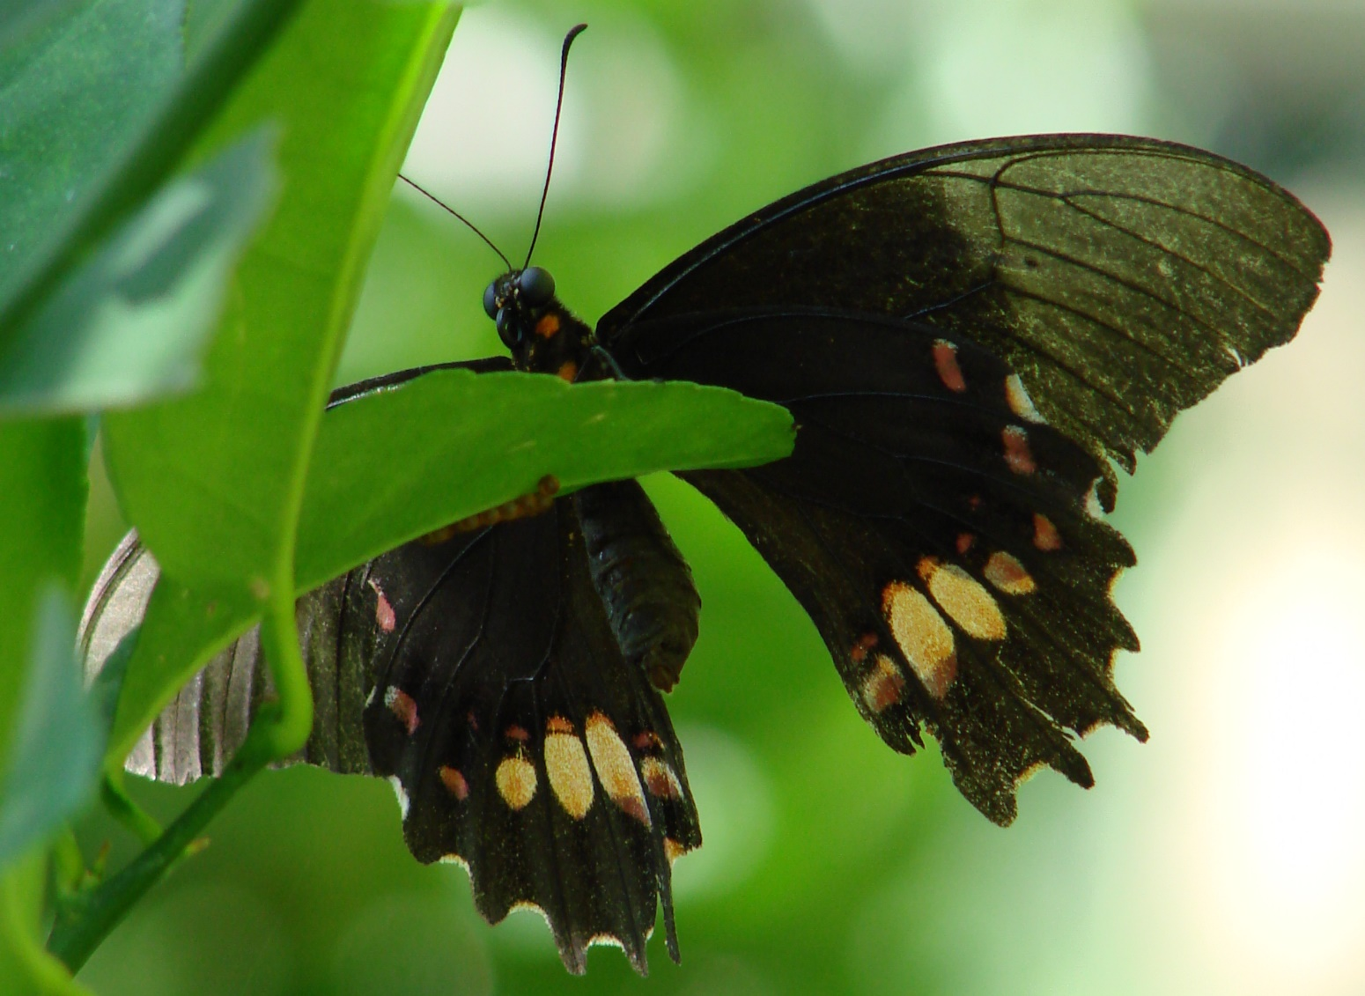
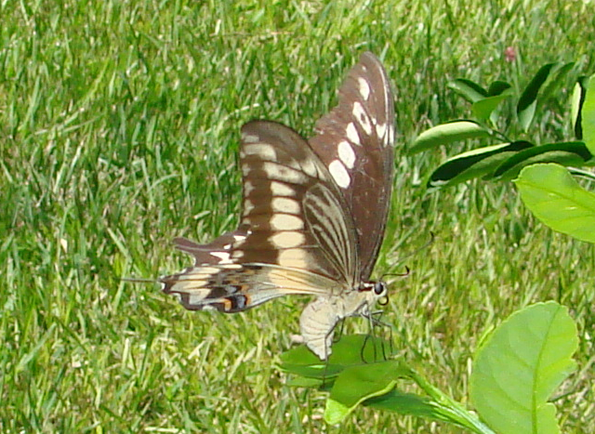
Quandry:
How do more when ability to travel is extremely limited?
A) Attract more butterflies to yard (improve garden)
B) Learn more about butterflies in yard (rear more caterpillars)
Ruby-spotted
Swallowtail
Ornythion
Swallowtail
Notes:
Garden then probably short L. Enjoyment of gardening and frustration of caterpillars disappearing when trying to observe them motivated me.

Slide 6
Garden: add varied nectar and host plants
Road
Church Parking Lot
Chomonques!
Public Garden: doesn’t look like much without rain!
Crucitas

Slide 7
Garden: add varied nectar and host plants
Road
Native/Naturalized Hosts for:
Manfreda Giant-Skipper
Elf, Banded & Crimson Patch, Mexican Bluewing, Leafwings, 2-3 Swallowtails, Southern Dogface, LOS, 3 Yellows, 3 Checkerspots, Vesta Crescent, 8+ Hairstreaks, 2 Whites, 6+Frits/Heliconians, 10+ Spreadwing skippers, grass
Chomonques!
Public Garden: doesn’t look like much without rain!
Crucitas

Slide 8
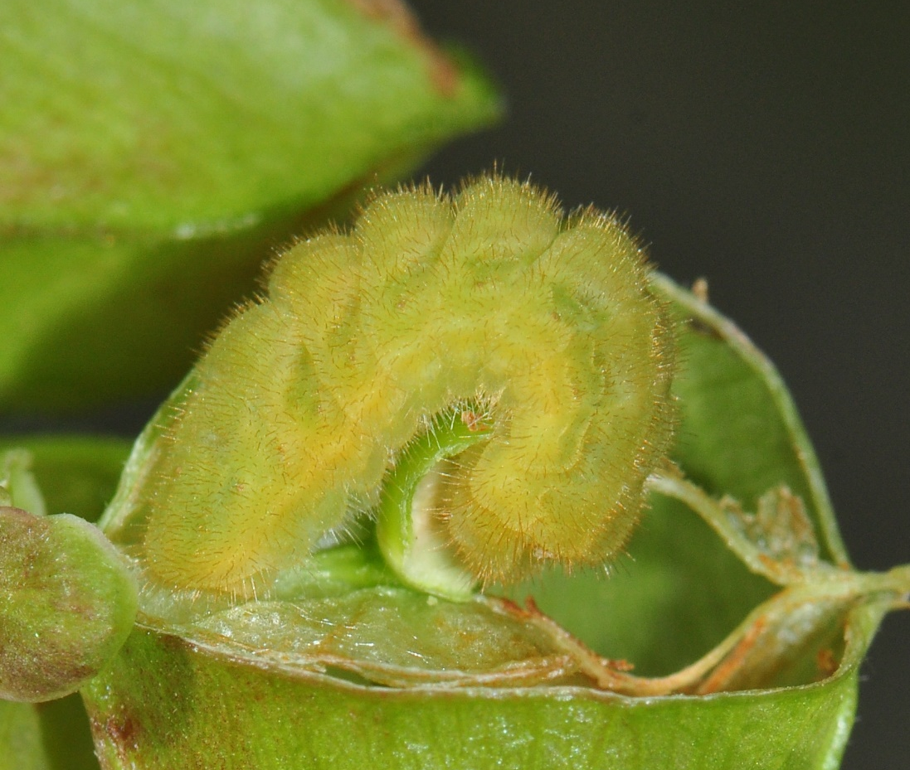
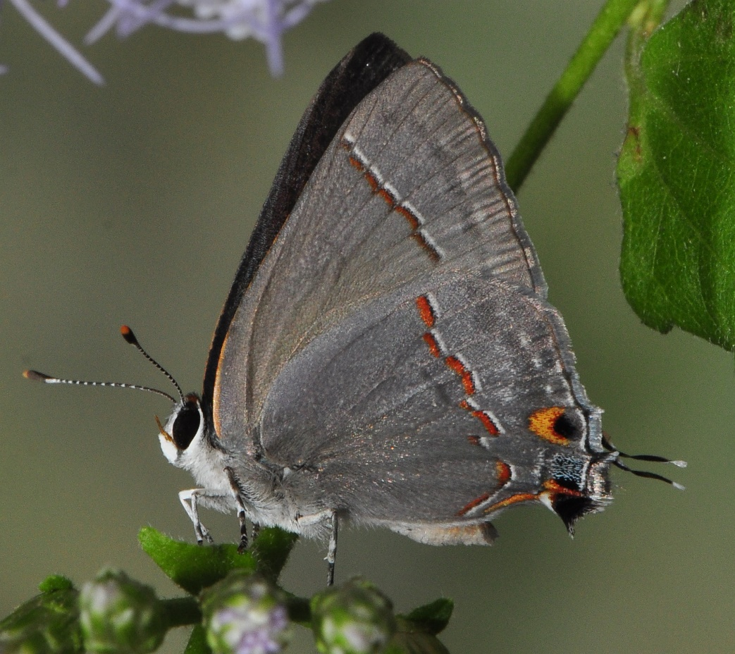
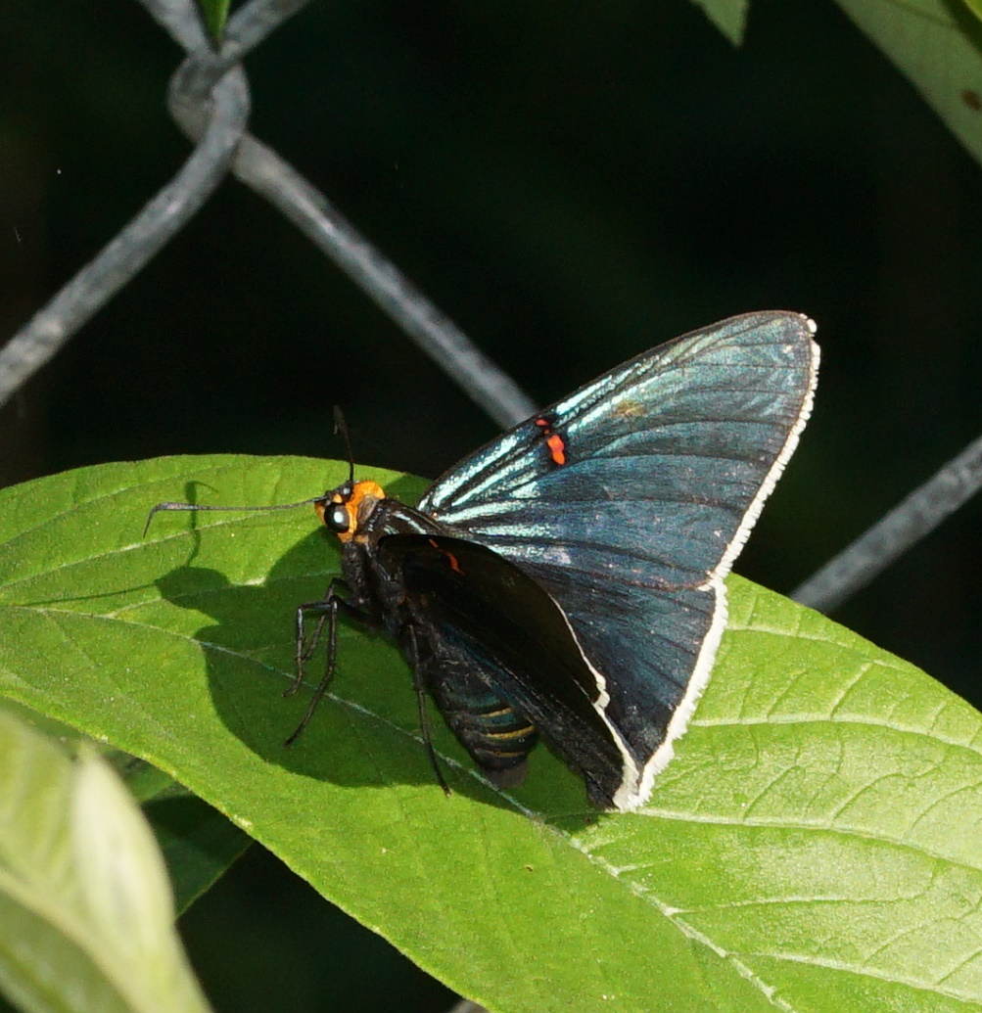
Garden: add varied nectar and especially host plants
Also Numerous “sensitive” natives + non-natives in containers or in dogs’ yard
Results:
First yard record for Guava Skipper: ovipositing on potted Guava tree.
First yard record for Red-lined Scrub Hairstreak: caterpillar
To date, I have recorded 99 species of butterfly immatures in yard (oviposition and caterpillars).

Slide 9
Observations:
Strategic plantings of nectar and host plants can truly benefit our butterfly species
Development in the LRGV is eating up much land that formerly was used by wildlife such as butterflies
This is one reason it is so important to plant natives as well as support NBC and our other valley parks that support butterflies!

Slide 10
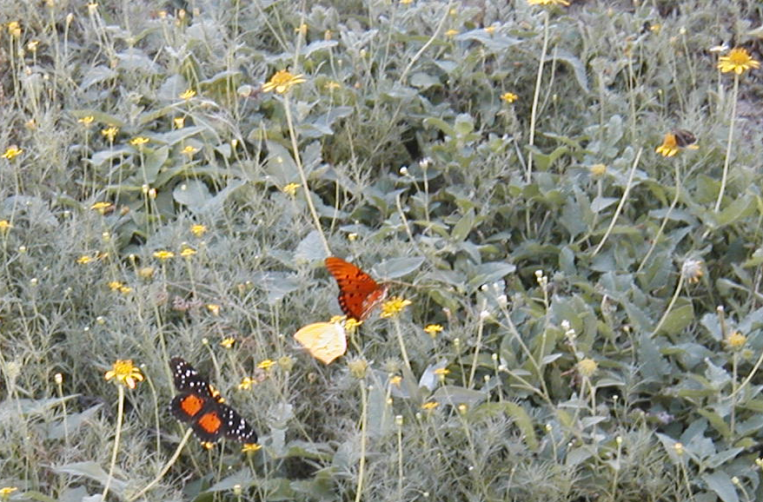
What will appear this year?: you never know about butterflies
Rain key: both amount and timing affect populations
October, 2004 –
Crimson Patch,
Tailed Orange, and
Gulf Fritillary
Notes:
Compare to this year -- barren!?!

Slide 11
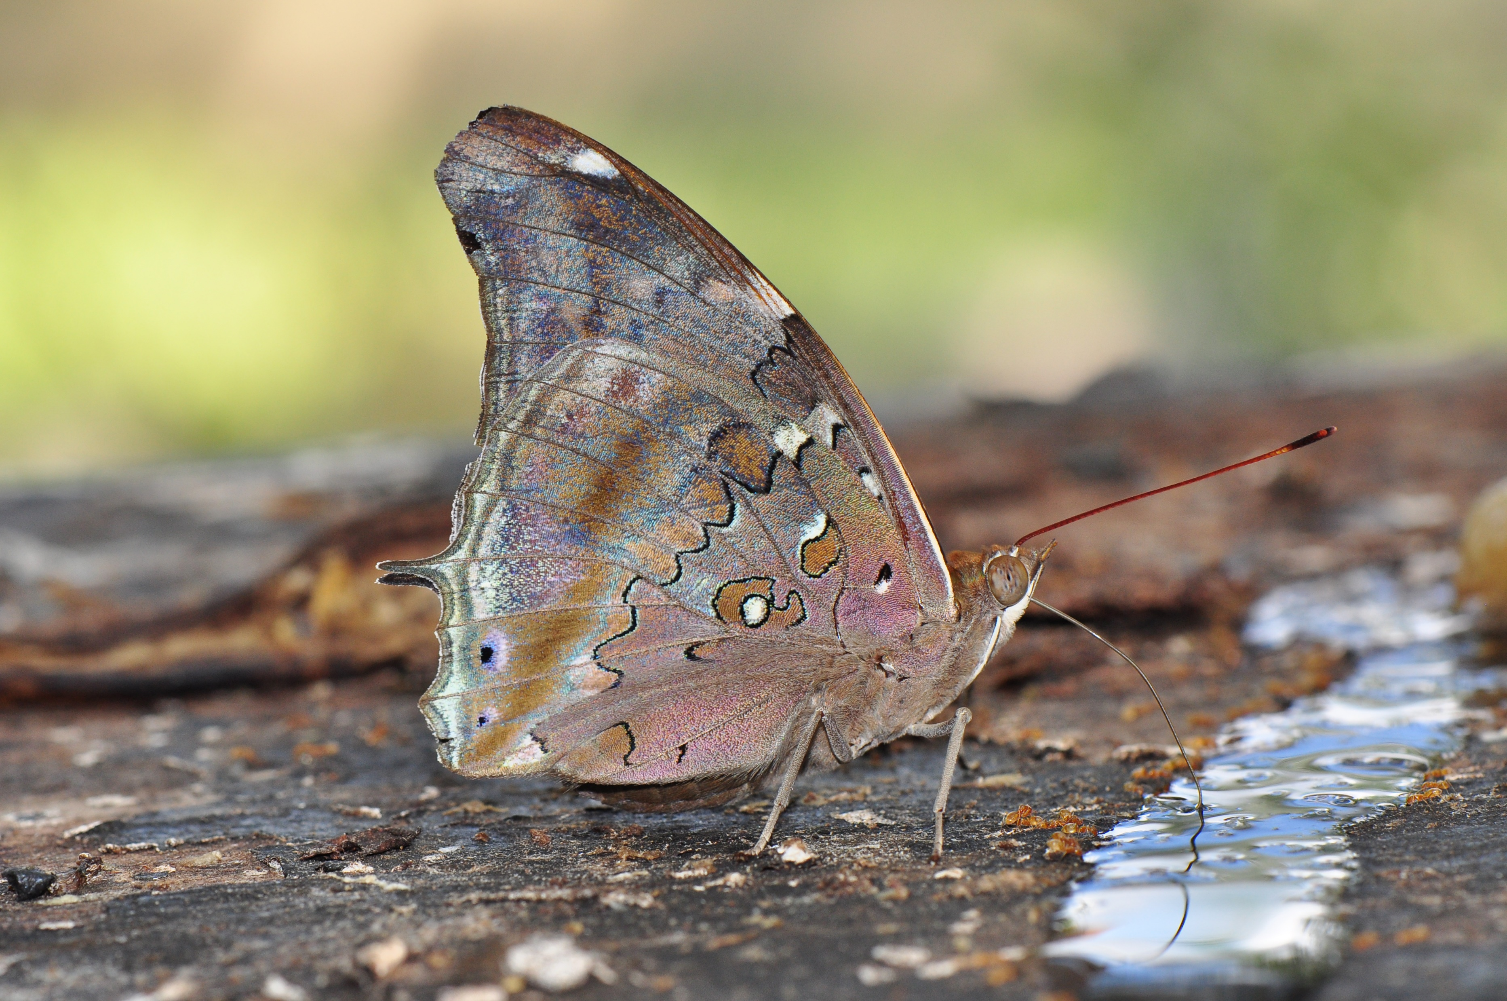
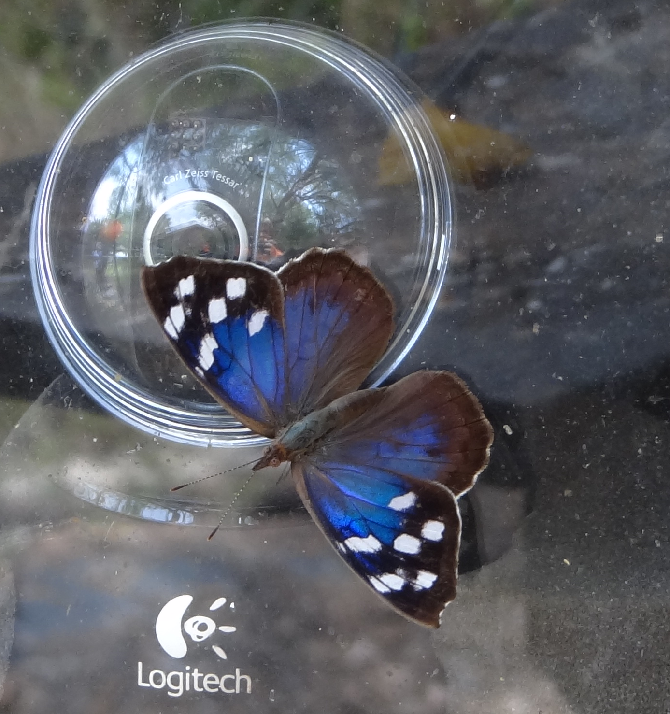
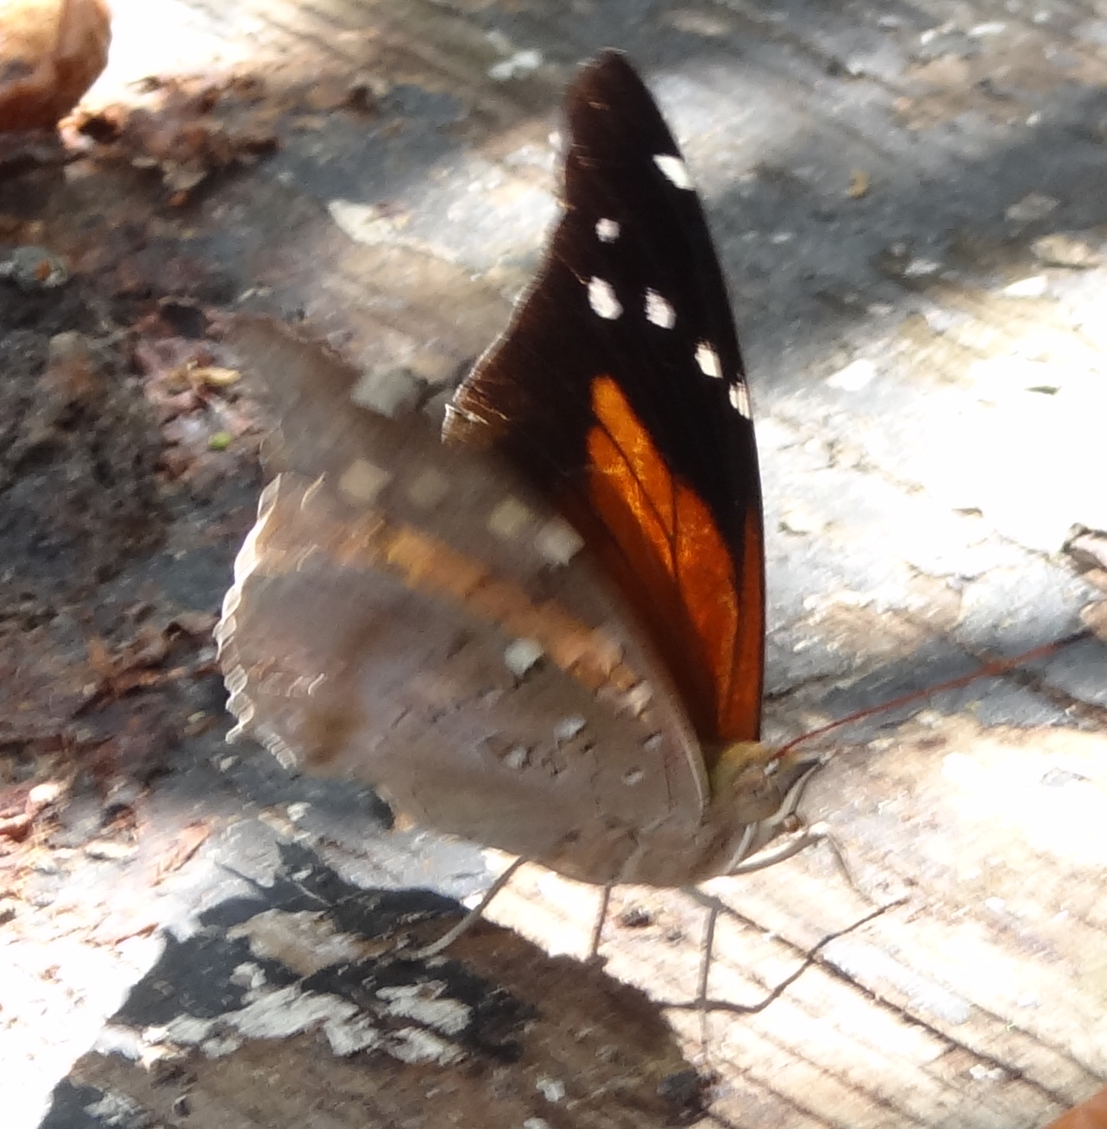
Boom or Bust
2011: Purplewings and Tailed Cecropian

Slide 12
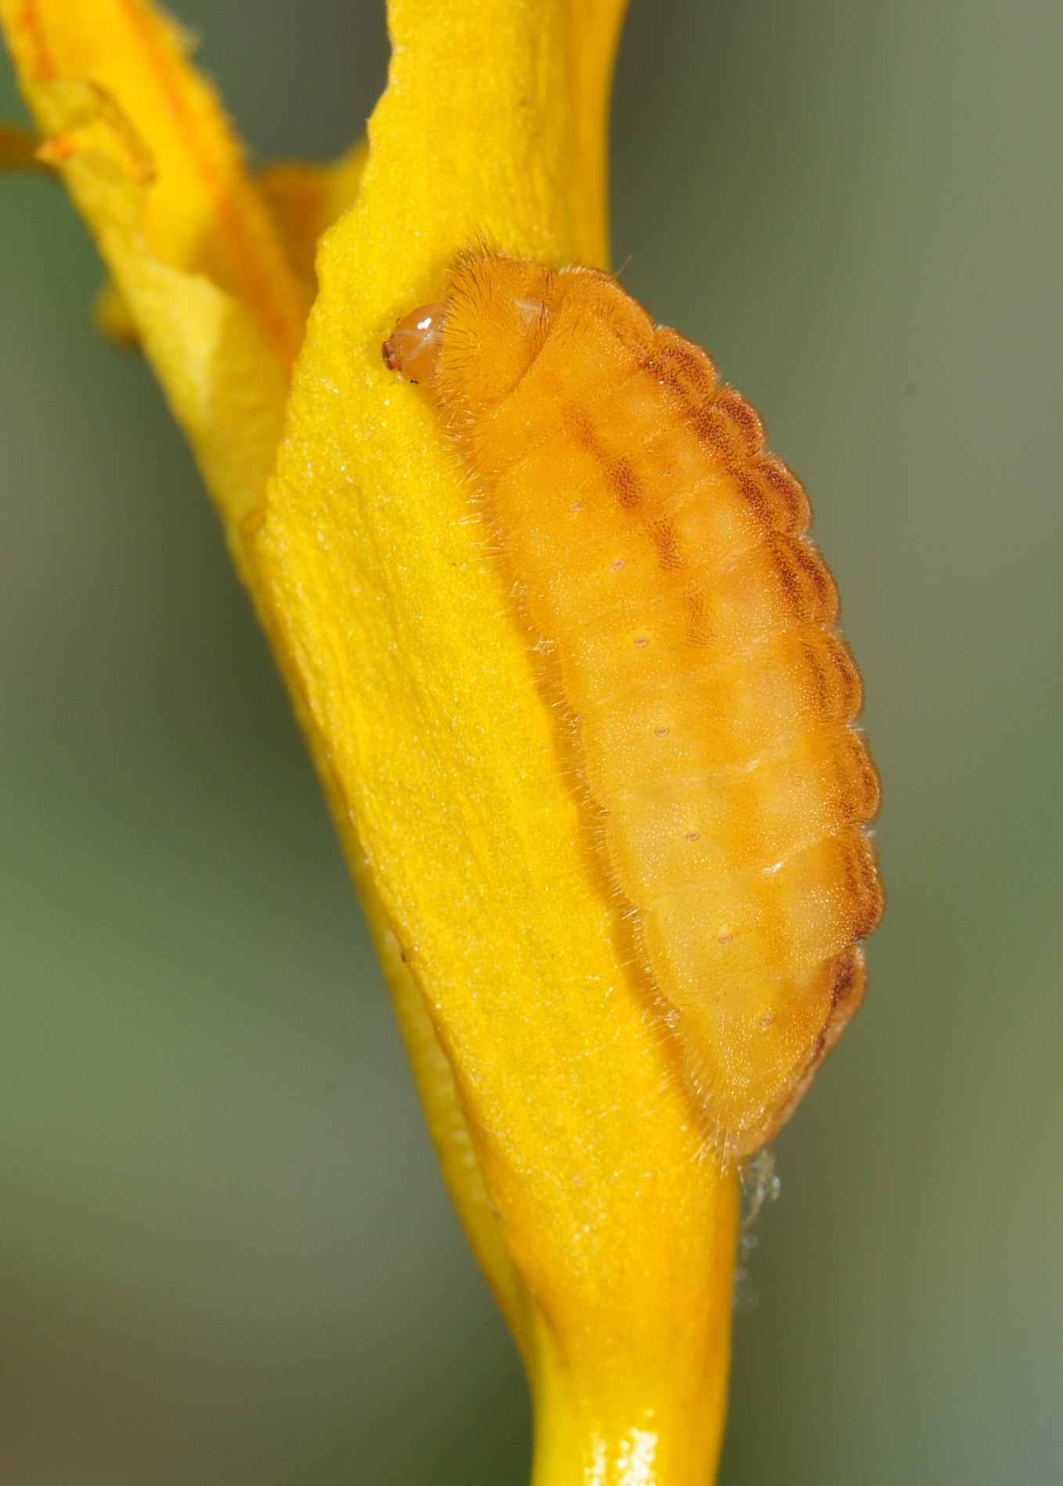
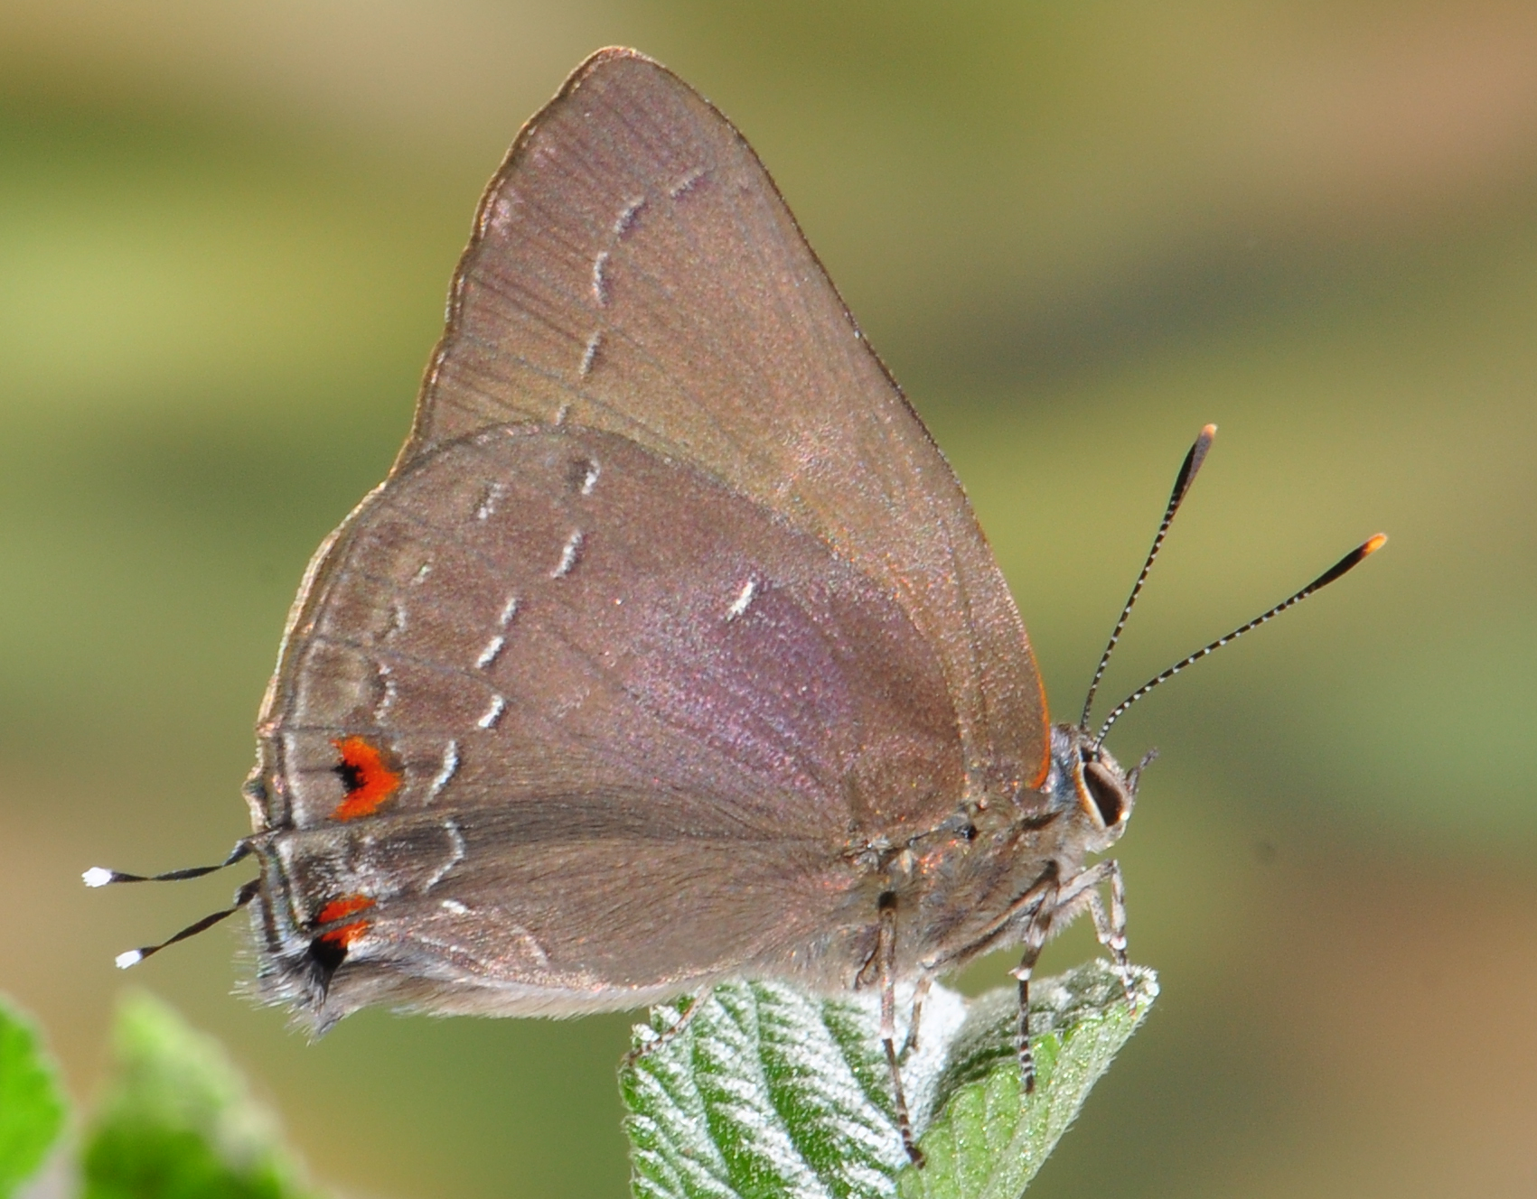
Boom or Bust
2017: Shadowed Hairstreak
Notes:
Hard freeze that winter may have destroyed colony?

Slide 13
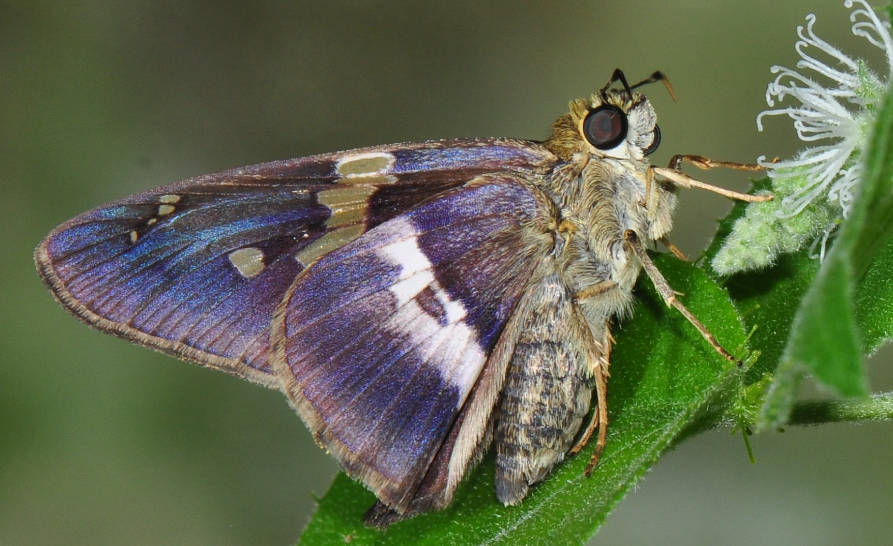
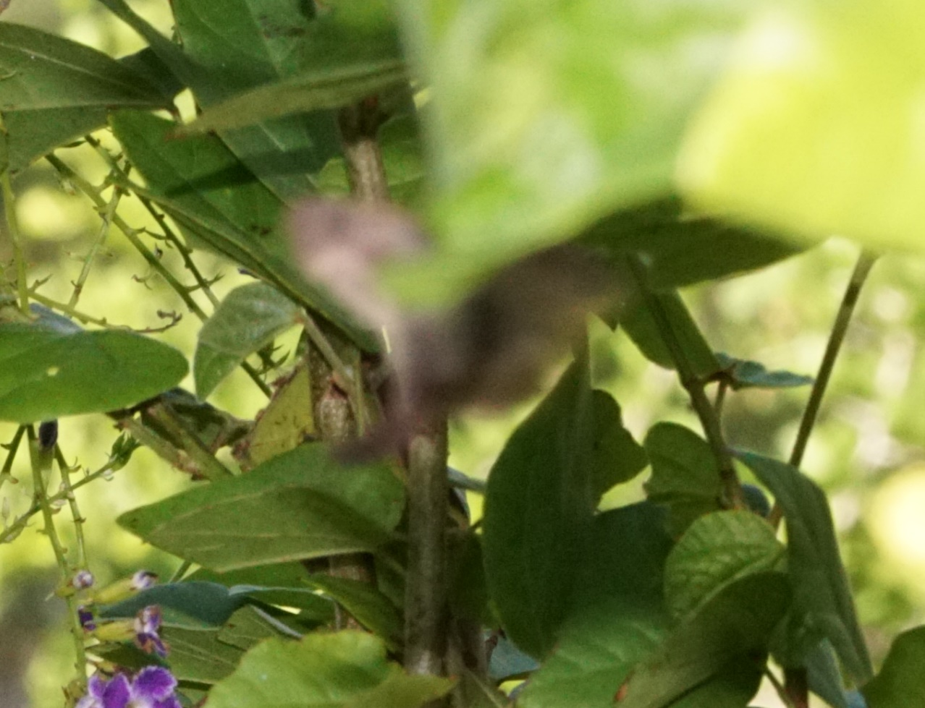
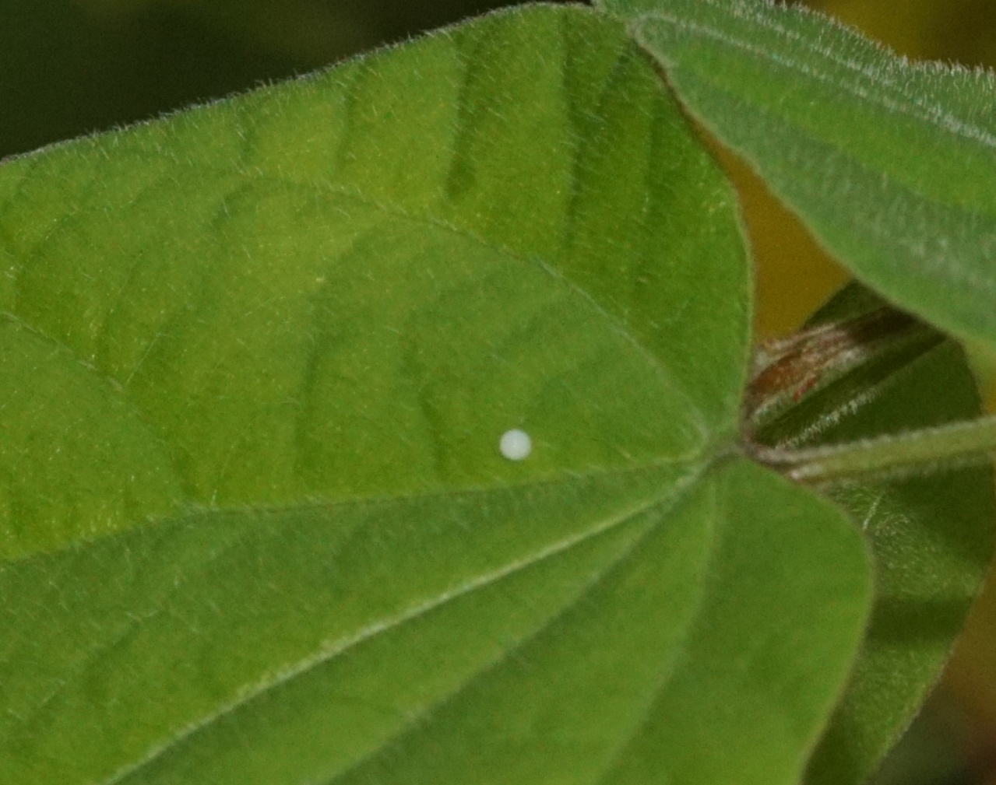
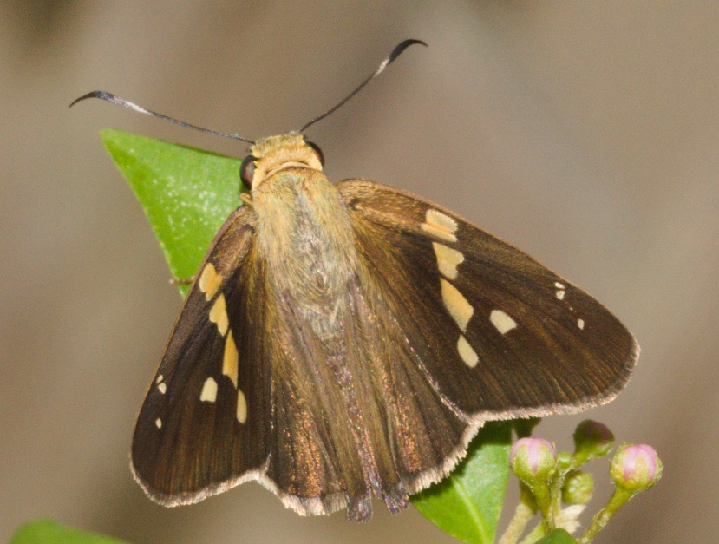
Boom or Bust
2020: Hurricane Hanna
Gold-spotted Aguna
Tailed Aguna
Notes:
August-September: 2 strong flights of Gold-Spotted

Slide 14
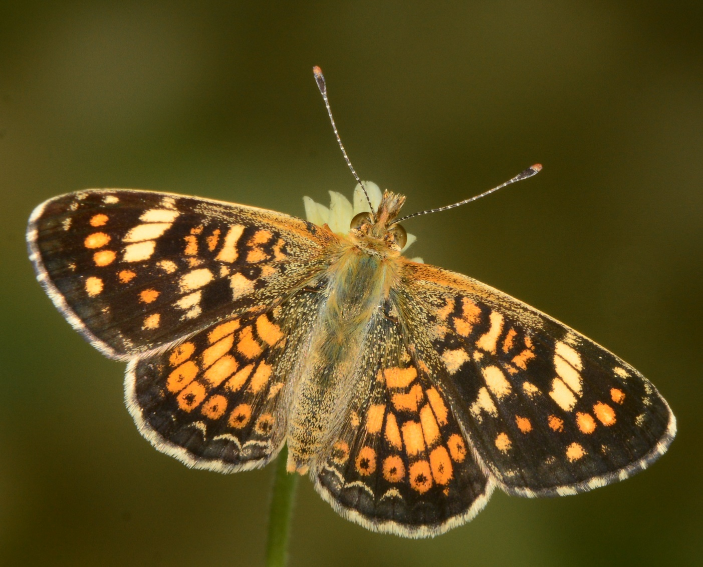
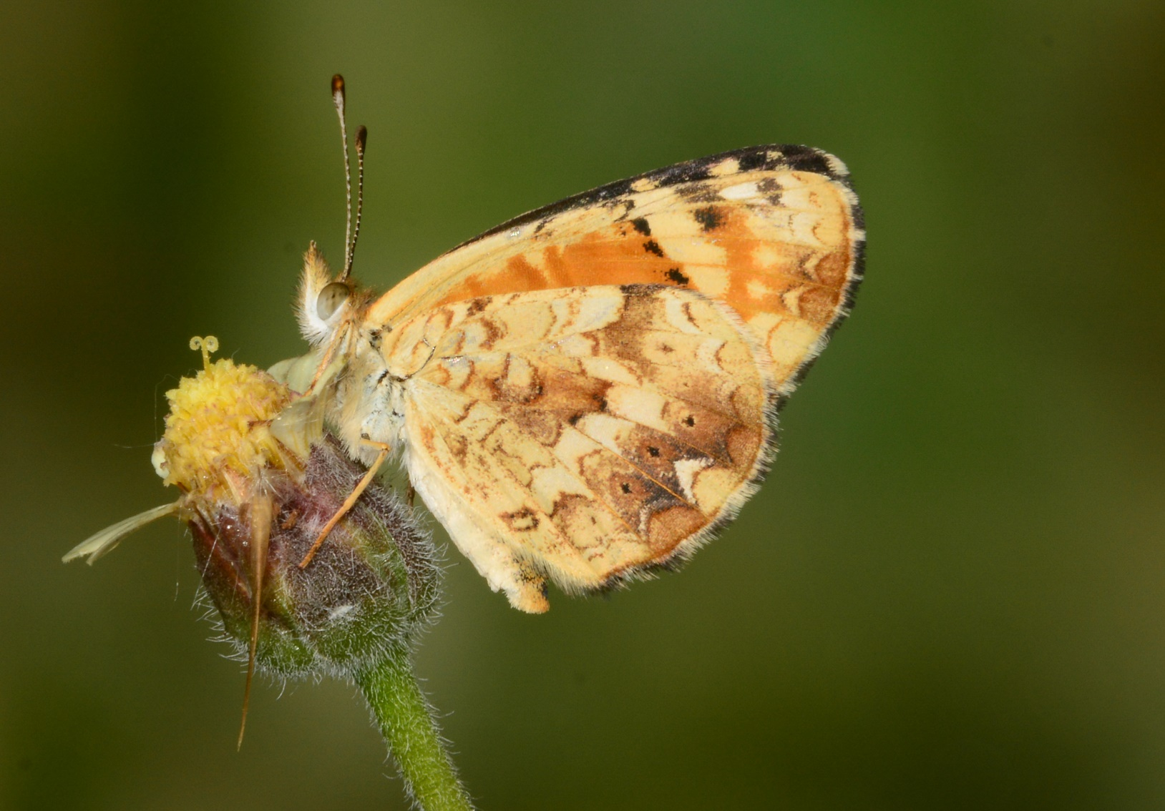
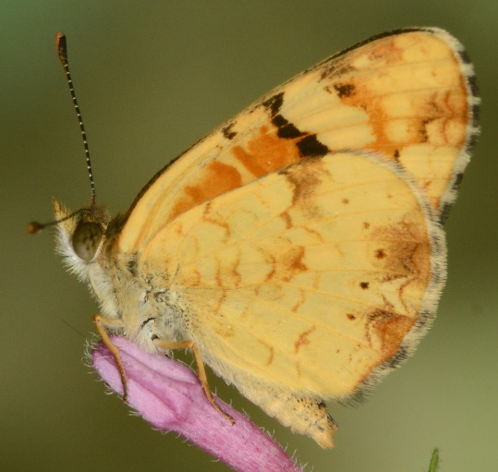
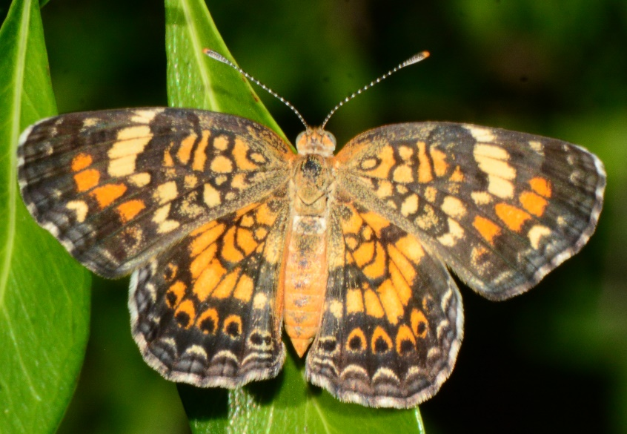
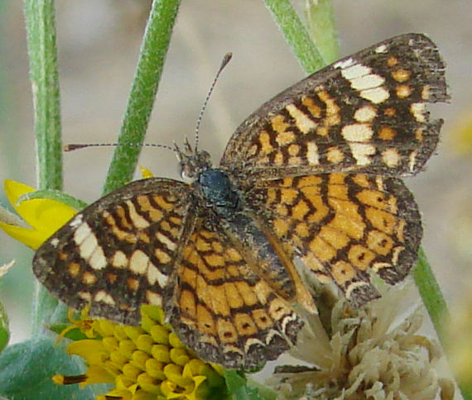
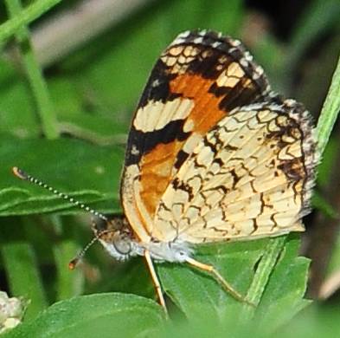
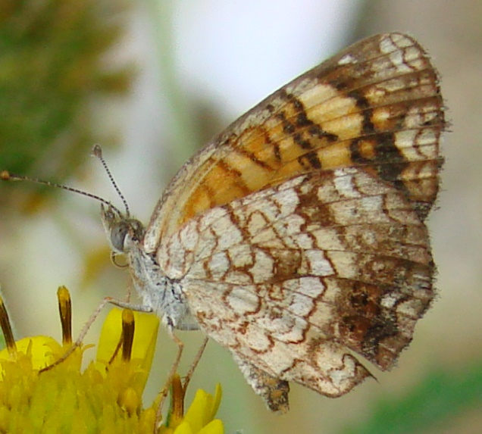
Boom (or perhaps new resident!)
2024-25: Mexican Crescent
Notes:
May be established! Female Vesta dorsal very hard to distinguish from MXC

Slide 15
Life Histories: a real joy
Berry Nall
leps.thenalls.net
berry@fhbaptist.com

